Slide 1
LIBRARY MANAGEMENT SYSTEM
By
Supriya Raghunath
Axis10JFSB1002

Slide 2
Introduction
Library Management System is a type of software which is developed to handle basic functions of a library
It helps to provide the information of the books present in the library
It keeps the tracks of the books present or added to the library.

Slide 3
Proposed System
Digitally keeps track of what books are available in the library.
Provides a user-friendly GUI environment.
Every data which will be stored in a structured manner.
All the information about the books will be stored according to the id.
Merits:
Work efficient.
Removes the manual process.
User friendly.

Slide 4





Technologies Used
Backend –Java in spring boot Application with Eureka server
Database- MySQL
Front-end – React and CSS

Slide 5
IMPLEMENTATION
ADMINISTRATOR(LIBRARIAN):
Admin will first registered with the required details.
Admin will login through the given login details. The admin can add, update and delete books.
The admin can also display all the book details and can search for a book with a particular id.

Slide 6
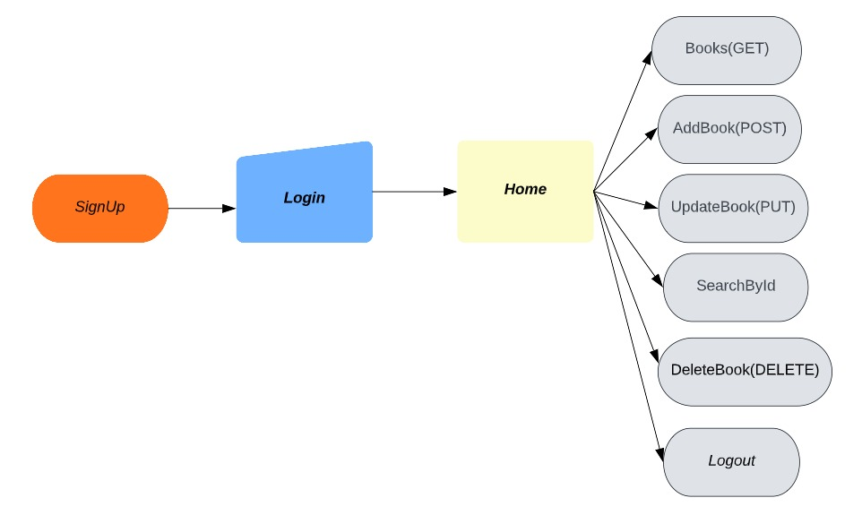
FLOW CHART

Slide 7
CONCLUSION
To record every transaction in computerized system so that problem such as record file missing won’t be there.
To design a user friendly interface of the Library Management System.

Slide 8


